Slide 1


Investor Presentation
ELEKTROTIM S.A.
Financial Results for 1H25
Wrocław, 9 September 2025

Slide 2




ELEKTROTIM – a Polish provider of power engineering services.
A trusted partner for your business.
Power Grids
Energy Sector
Railway Traction
Installations and Infrastructure
Industry
Public Utility Infrastructure
Defense

Slide 3









Key Figures
26 years
1500+
5000+
on the Polish power engineering market
satisfied customers since 1999
completed projects since 1999
Since 2007
since 2023
PLN 25 million
Listed on the Warsaw Stock Exchange
Part of the sWIG80 index
Dividend payout for 2024
93%
PLN 727 million
Over PLN 540 million
1Y Share Return
Backlog as of June 30, 2025
Record Market Capitalization of the Company

Slide 4
Market Environment
Stagnation in the construction sector
Stabilization of construction material prices
High competition in the construction industry
Development and modernization of power grids
Risk of workforce shortages

Slide 5
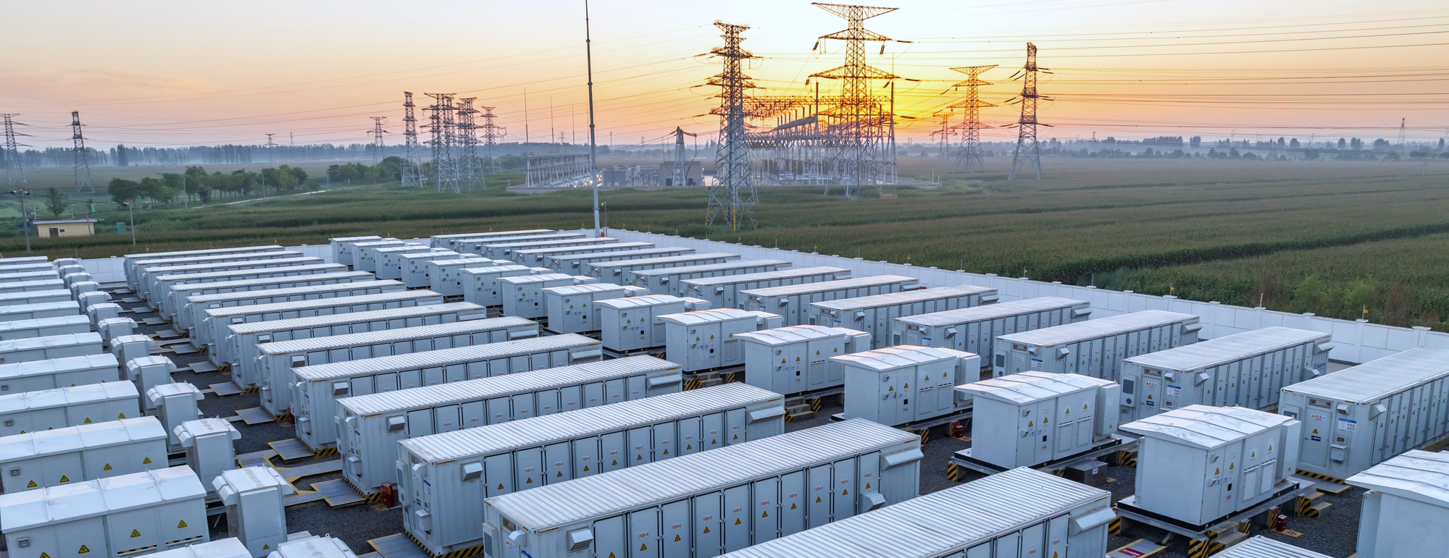
Presentation Agenda
01
02
03
Key Events
at ELEKTROTIM S.A.
Financial Results of ELEKTROTIM S.A.
Q&A

Slide 6
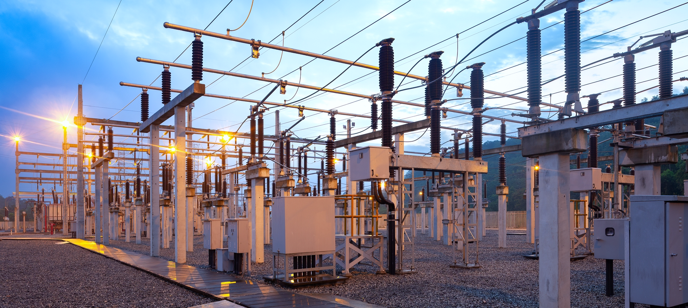
01 Key Events at ELEKTROTIM S.A.

Slide 7
Key Contracts Signed in 1H 2025
(net amounts)
STOEN OPERATOR
EDF Renewables Polska
TAURON Dystrybucja
Modernization of 110/15 kV substation in Białołęka
Construction of an energy storage facility in Stary Grodków
Modernization of 110/15 kV substation in Dworszowice
PLN 37 million
PLN 27 million
PLN 25 million
TAURON Dystrybucja
POLONEZ PLUS
ENEA Operator
Modernization of 110/20 kV substation in Marciszów
Electrical installations as part of Mercedes Benz Jawor investment
Reconstruction of 110/15 kV substation in Golczewo
PLN 25 million
PLN 24 million
PLN 23 million
TAURON Dystrybucja
STRABAG
TAURON Dystrybucja
Construction of a 20 kV switchgear at Wirek substation
Construction and reconstruction of airport pavements at Wrocław Airport
Construction of a 110 kV cable line with fiber optic line, GPZ Wieczysta – GPZ Mennicza-Wrocław
PLN 21 million
PLN 21 million
PLN 17 million

Slide 8
Contracts Signed After 1H 2025
(net amounts)
Energa Operator
Polskie Elektrownie Jądrowe
(Polish Nuclear Power Plants)
Construction of RS 110 kV Elbląg North substation and connections of cable lines to the 110 kV grid
Design and construction of a 110/15 kV power substation with supply lines in Choczewo/Poland
PLN 34 million
PGE Energetyka Kolejowa
Construction of PT Kościerzyna traction substation, supply lines, traction power cables, return cables, control and telecommunication systems
PLN 162 million
PLN 16 million

Slide 9
Backlog
As of 31 July 2025 [PLN million]
330
246
727
PLN million
as of 30 June 2025
Value of contracts signed in 1H 2025
Value of contracts signed after 1H 2025
439
676
Power grid projects
237
as of 31 July 2025
Installations and infrastructure

Slide 10
Backlog
[PLN million]
40 million PLN
Value of contracts pending signature
358 million PLN
Planned backlog execution in 2025
318 million PLN
Planned backlog execution in 2026–2027
12% year-on-year increase in backlog value as of 31 July 2025

Slide 11
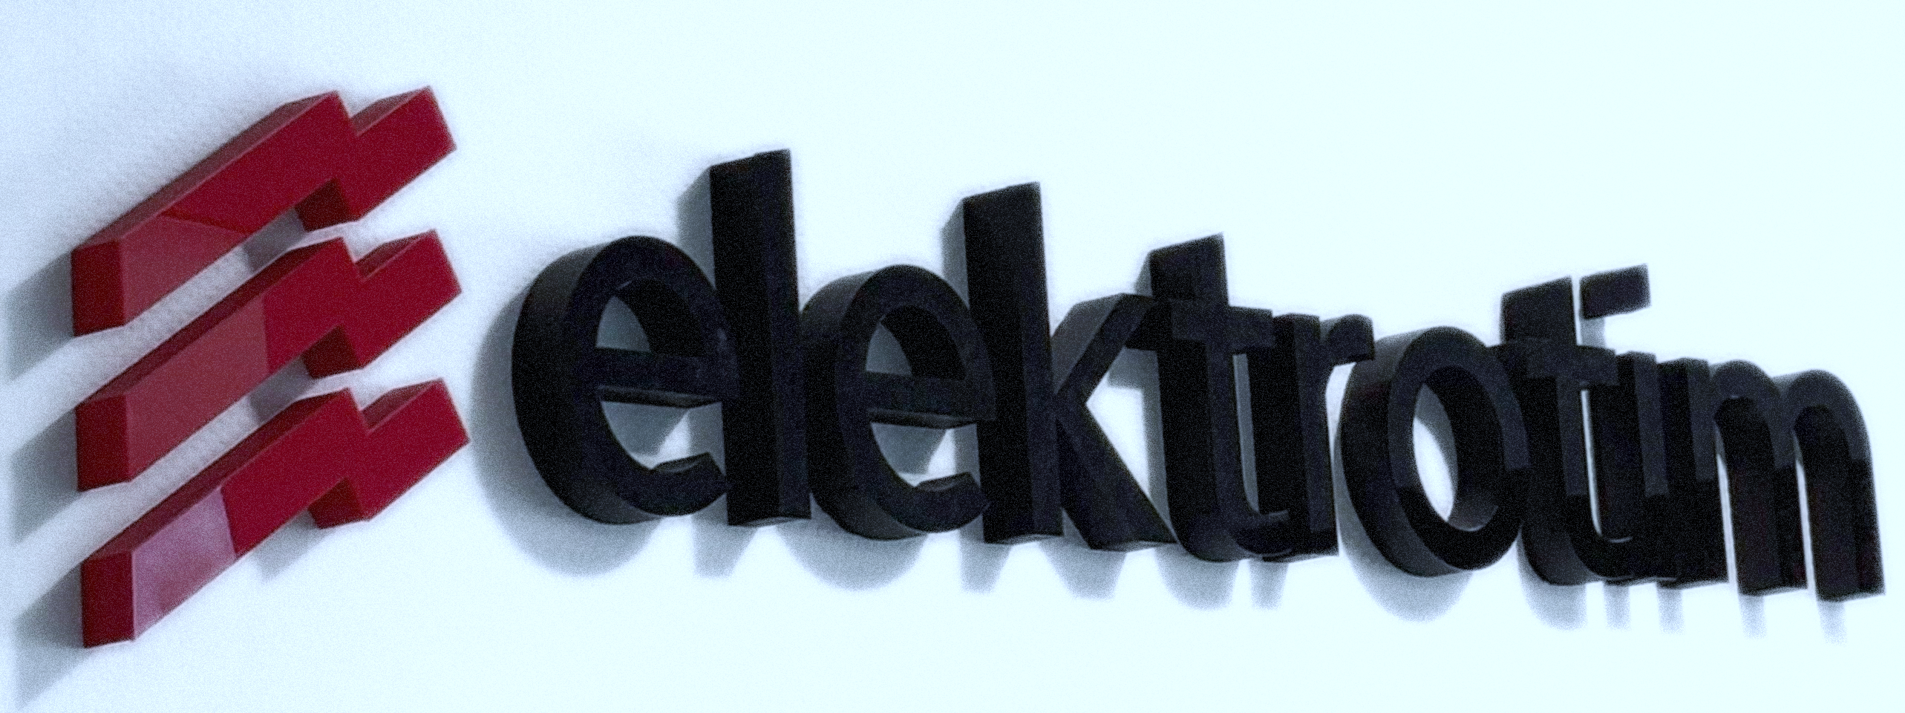
02 Financial Results of ELEKTROTIM S.A.

Slide 12
Income Statement
Standalone results for 1H 2025 (PLN ‘000)
Item | 1H 2025 | 1H 2024 | Change |  | Change %
Sales revenue | 202 545 | 172 947 | 29 598 |  | 17%
Gross profit on sales | 24 067 | 25 522 | -1 455 |  | -6%
Gross margin | 11,9% | 14,8% | -2,9pp
Selling expenses | 6 015 | 5 508 | 507 |  | 9%
General administrative expenses | 8 285 | 8 040 | 245 |  | 3%
Operating balance | 819 | 3 927 | -3 108 |  | -79%
Operating profit (EBIT) | 10 586 | 15 901 | -5 315 |  | -33%
Operating margin | 5,2% | 9,2% | -4,0pp
EBITDA | 13 006 | 17 898 | -4 892 |  | -27%
Financial result | -1 075 | -386 | -689 |  | 178%
Gross profit | 9 511 | 15 515 | -6 004 |  | -39%
Net profit | 7 321 | 13 033 | -5 712 |  | -44%
Net margin | 3,6% | 7,5% | -3,9pp
Change in provisions policy: increase of PLN 2.6 million
No positive effect from the release of provisions related to RZI Gdynia

Slide 13
Standalone Revenues
by Segment
59%
61%
41%
39%
(PLN ‘000)

Slide 14
Standalone Balance Sheet
Assets
Item | 30.06.2025 | 31.12.2024 |  | Change |  | Change %
Non-current assets, incl.: | 38 277 | 37 980 |  | 297 |  | 1%
Intangible assets and goodwill | 2 830 | 2 785 |  | 45 |  | 2%
Property, plant and equipment | 19 808 | 19 519 |  | 289 |  | 1%
Long-term investments and other non-financial assets | 15 639 | 15 676 |  | -37 |  | 0%
Current assets | 219 558 | 220 647 |  | -1 089 |  | 0%
Inventories | 4 499 | 8 460 |  | -3 961 |  | -47%
Trade receivables | 95 019 | 90 063 |  | 4 956 |  | 6%
Contract assets | 112 331 | 74 783 |  | 37 548 |  | 50%
Cash and cash equivalents | 7 709 | 47 341 |  | -39 632 |  | -84%
Total assets | 257 835 | 258 627 |  | -792 |  | 0%
(PLN ‘000)

Slide 15
Standalone Balance Sheet
Equity and Liabilities
Item | 30.06.2025 | 31.12.2024 |  | Change |  | Change %
Equity | 111 763 | 129 399 |  | -17 636 |  | -14%
Non-current liabilities | 23 887 | 22 943 |  | 944 |  | 4%
Current liabilities | 122 185 | 106 285 |  | 15 900 |  | 15%
– of which trade and other payables | 67 435 | 75 401 |  | -7 966 |  | -11%
Total equity and liabilities | 257 835 | 258 627 |  | -792 |  | 0%
(PLN ‘000)

Slide 16
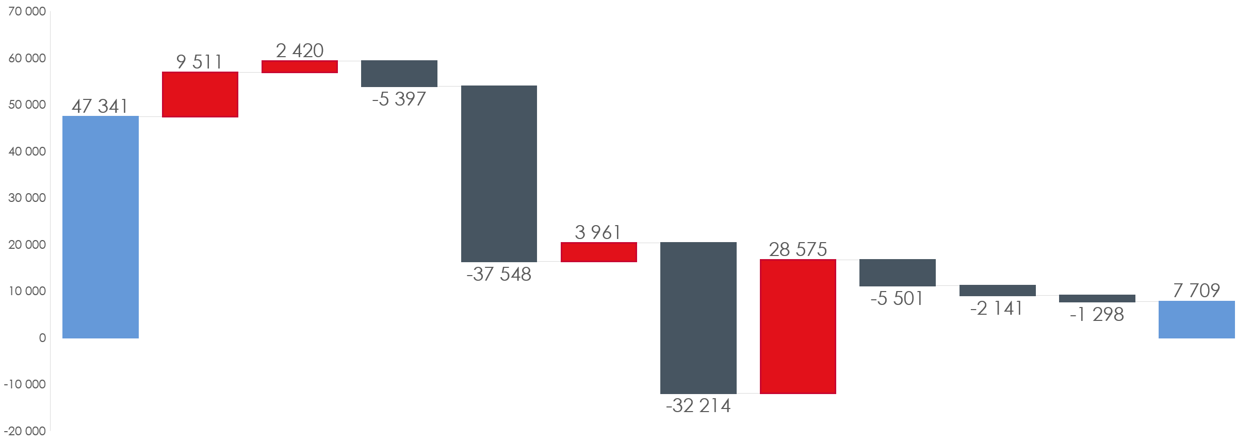
Cash flow
(PLN ‘000)

Slide 17
Liquidity Ratios
30.06.2025 30.06.2024
(PLN ‘000)

Slide 18
Scale Growth Dynamics
CAGR*
+18.3%
CAGR*
+14.7%
* CAGR – Compound Annual Growth Rate

Slide 19
Sources of Financing
30.06.2025
31.03.2025
Credit and factoring limits (PLN million)
231
238
Guarantee limits (PLN million), including:
451
463
Insurance guarantees (PLN million)
190
188
Insurance guarantees (EUR million)
6
6
Bank guarantees (PLN million)
236
253

Slide 20
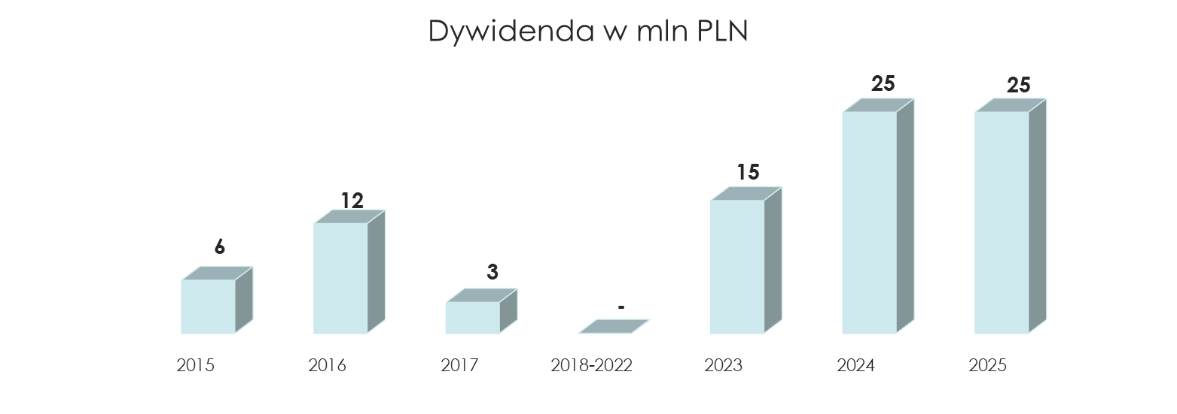
Dividend Policy
Dividend per share (PLN)
PLN 25 million
PLN 2.5 per share
Dividend per share (PLN)
Total dividend in 2023–2025: PLN 65 million (PLN 6.5 per share)
Dividend payment date: 25 July 2025

Slide 21
Growth Perspectives
Energy transition
Development of nuclear and wind power
Border protection and defense
Energy storage
Central Communication Port (CPK)
Power supply for railway infrastructure

Slide 22
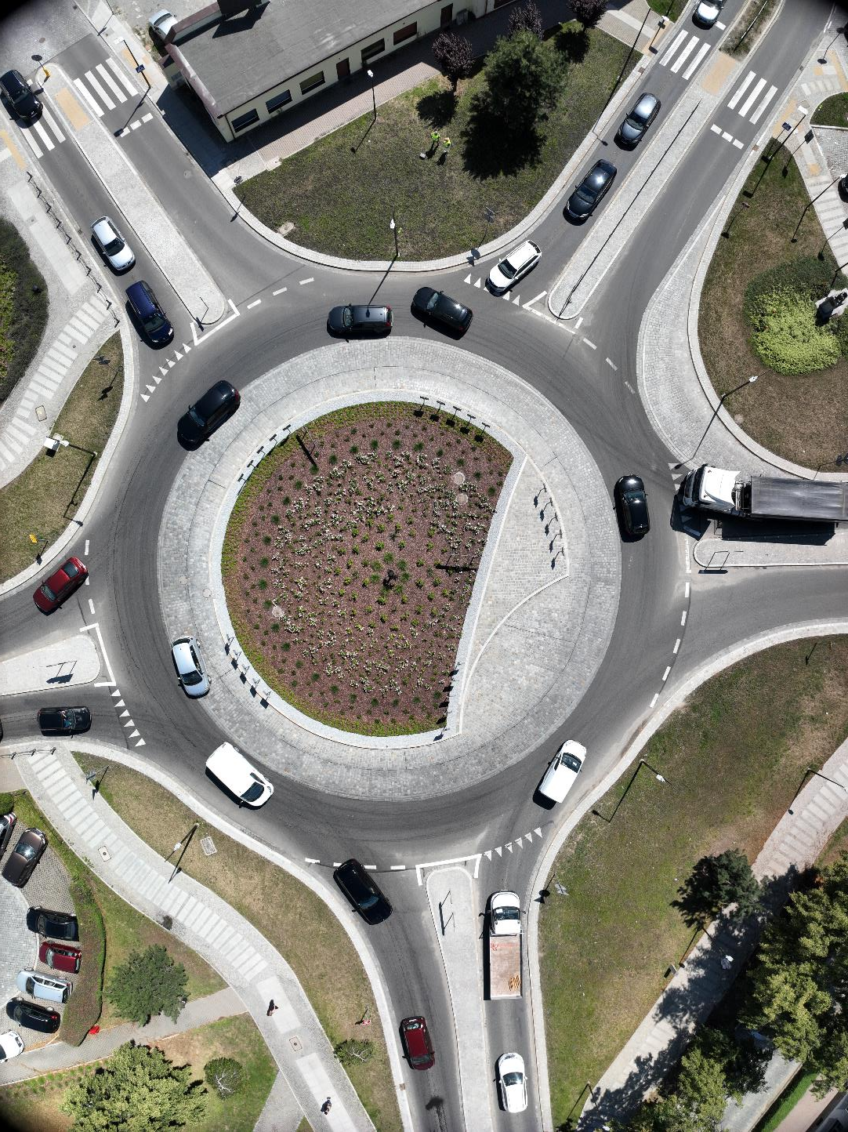

Current Plans and Operational Goals
New strategy for 2026–2030
Further development of the Company
in the areas of power engineering and infrastructure installations
Ongoing digitalization and IT
modernization of the Company
Optimization of internal processes

Slide 23
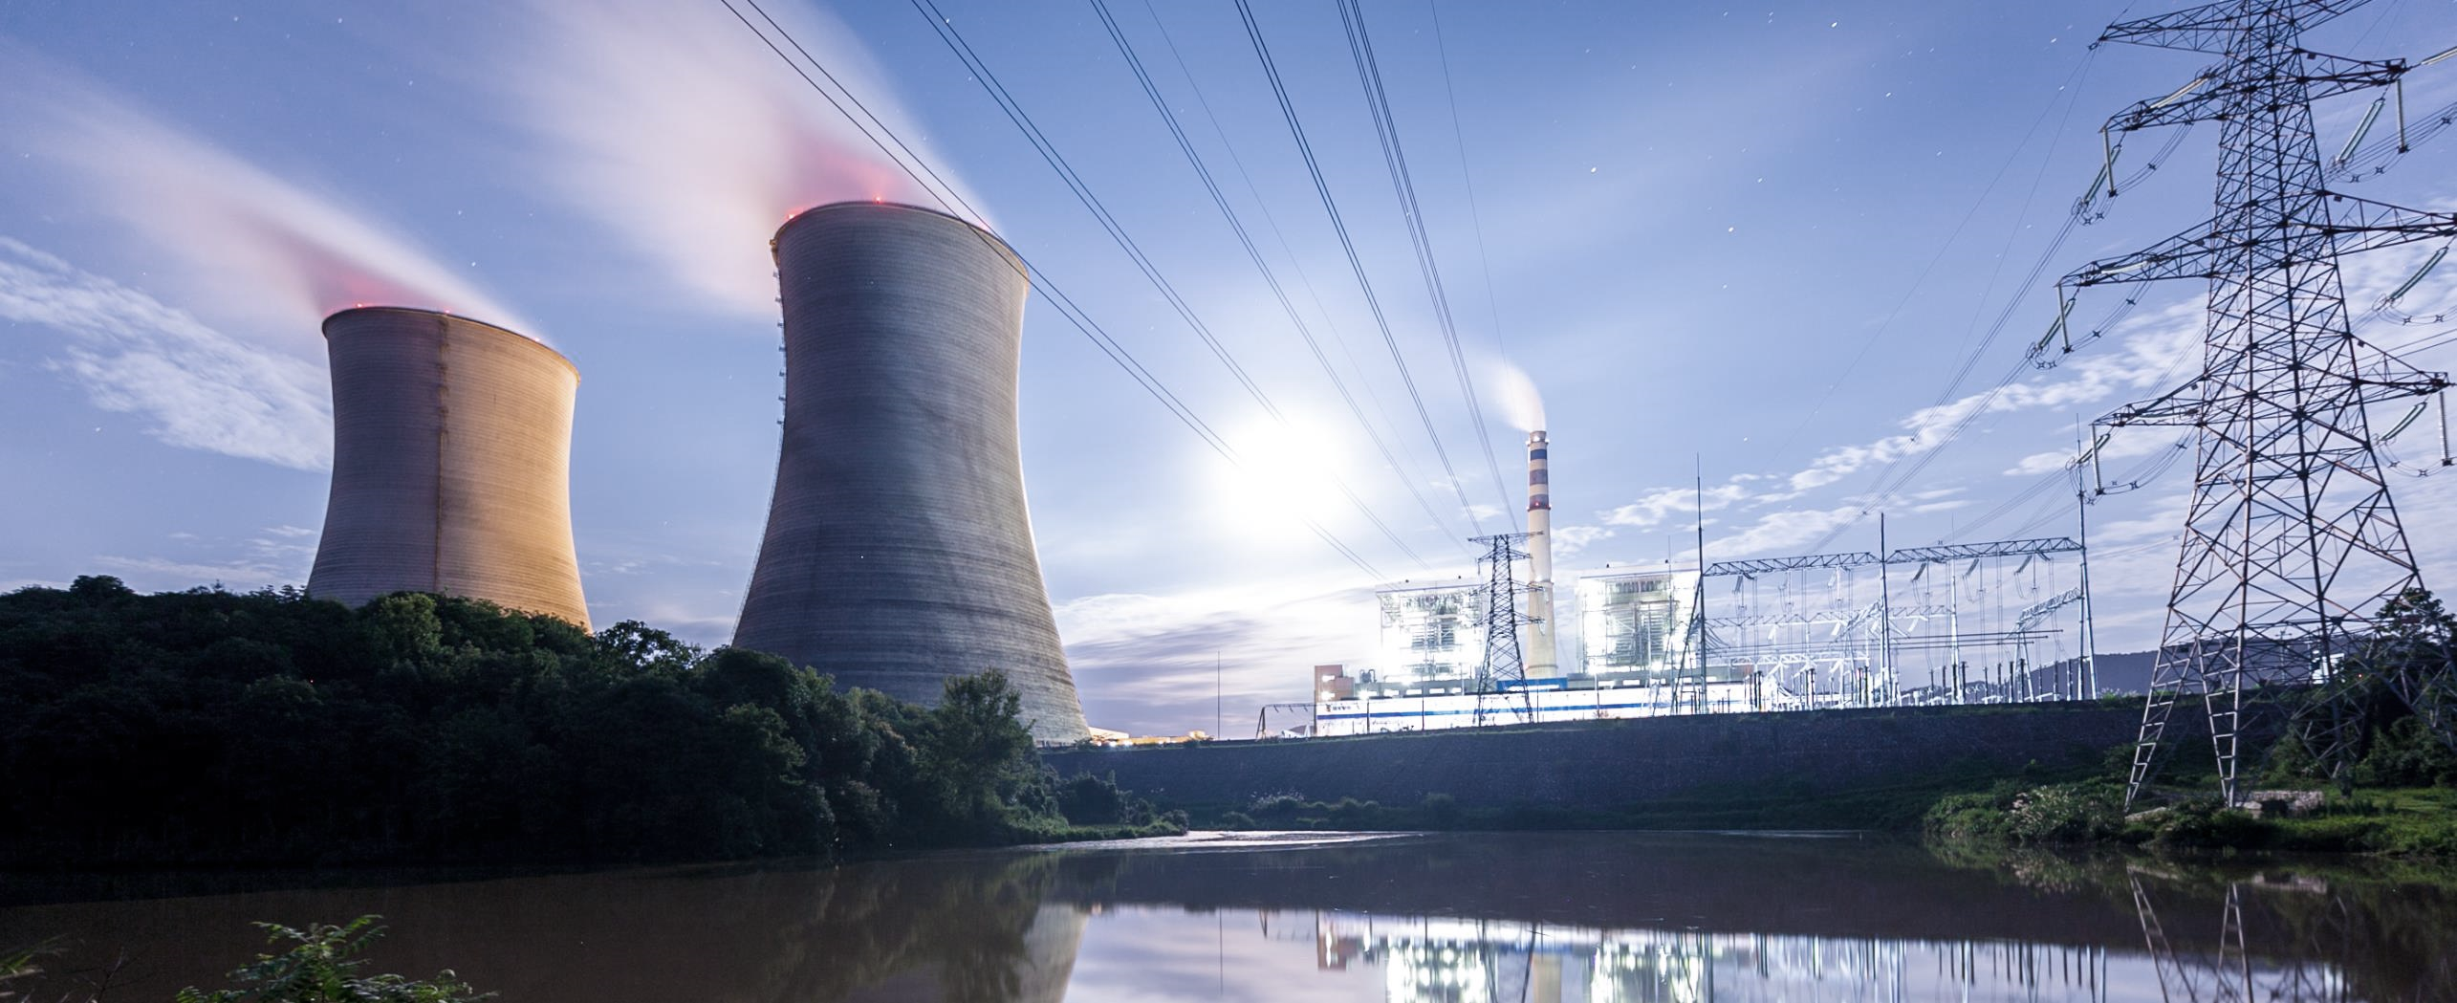
03 Q&A

Slide 24

Thank You!

